Slide 1
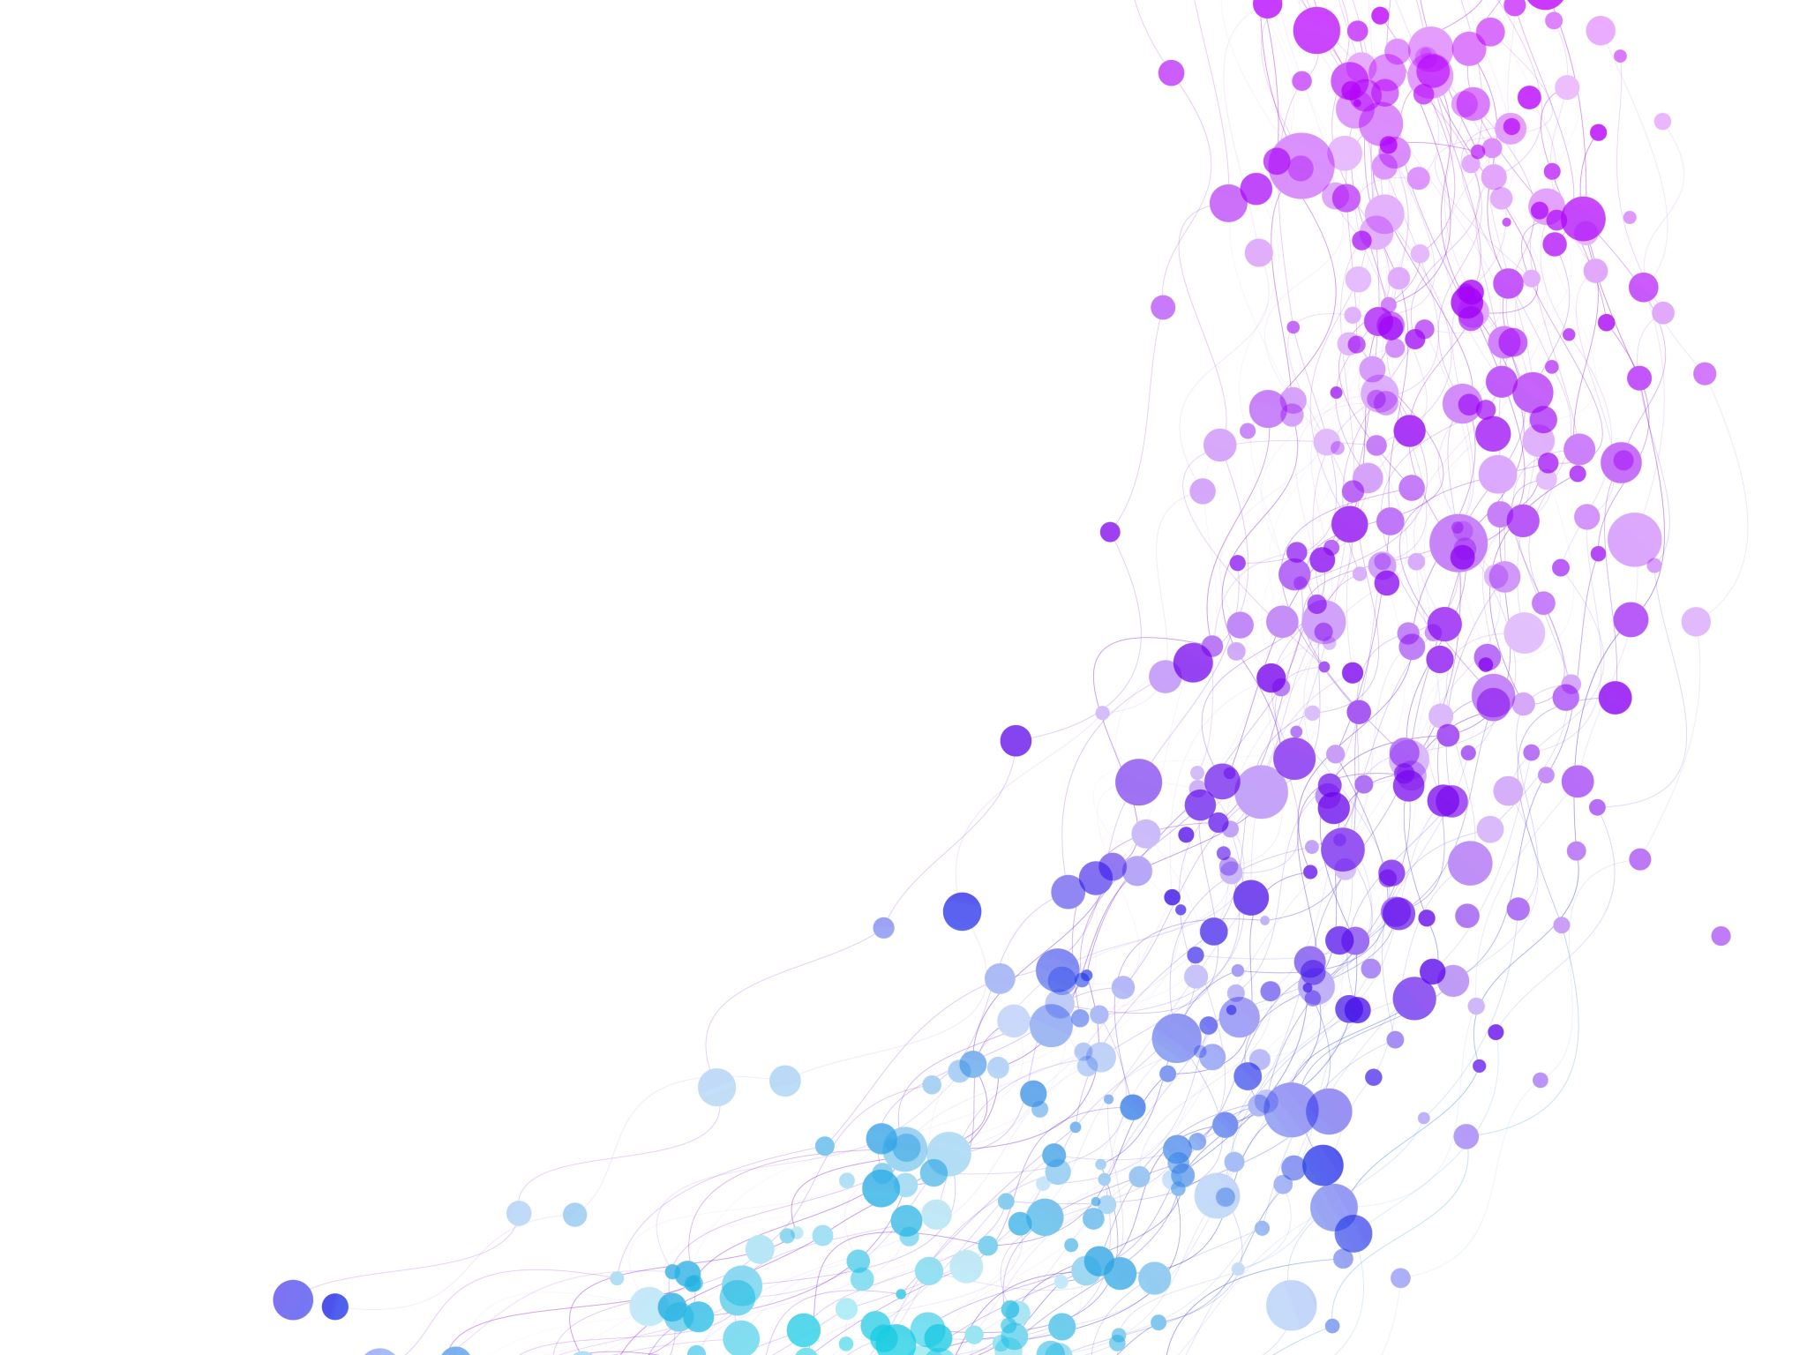


Introduction Data Structures Session No.: 1 Course Name: Data Strucutres Course Code: R1UC308B Instructor Name: Dr. Gaurav Agarwal Duration: 50 mins Date of Conduction of Class: 21 Aug 2025

Slide 2

Review
Pre-Requisite :
Students must have knowledge of C/C++ programming language.

Slide 3

Pre-Class Assessment
[2-mins]

Slide 4

[1-mins]
What is Data Structure?

Slide 5
Learning Outcomes
[2-mins]
By the end of this session, You will be able to:
Define key terms related to data structures such as data, data type, abstract data type (ADT), and operations..
Classify different types of data structures and identify real-life applications for each.

Slide 6
Session Outline
Introduction to Data and Data Structures
Types of Data Structures
Applications of Data Structures
Provide hands-on activities and reinforce learning through an interactive WooClap and WooFlash tools.

Slide 7

Activity-1 (Think – Pair – Share)
[1-mins]
What is the Data Structures and their needs?
Data Structures

Slide 8
Concept and Definition for (LO-1)
What is Data Structure?
- A data structure is a particular way of organizing data in a computer so that it can be used effectively. The idea is to reduce the space and time complexities of different tasks.
- The choice of a good data structure makes it possible to perform a variety of critical operations effectively.
- An efficient data structure also uses minimum memory space and execution time to process the structure.
- A data structure is not only used for organizing the data. It is also used for processing, retrieving, and storing data.

Slide 9
Concept and Definition for (LO-1) Need of Data Structures
The structure of the data and the synthesis of the algorithm are relative to each other. Data presentation must be easy to understand to the developer, as well as the user, can make an efficient implementation of the operation. Data structures provide an easy way of organizing, retrieving, managing, and storing data.
Here is a list of the needs for data structure.
▶ Data structure modification is easy.
▶ It requires less time.
▶ Save storage memory space.
▶ Data representation is easy.
▶ Easy access to the large database

Slide 10
Concept and Definition for (LO-1) Classification / Types of Data Structures
Linear Data Structure
2. Non-Linear Data Structure
Linear Data Structure: Elements are accessed in a sequential order but it is not compulsory to store all elements sequentially (say, Linked Lists).
Examples: Linked Lists, Stacks and Queues.
Non-Linear Data Structure: Elements of this data structure are stored/accessed in a non-linear order.
Examples: Trees and graphs

Slide 11
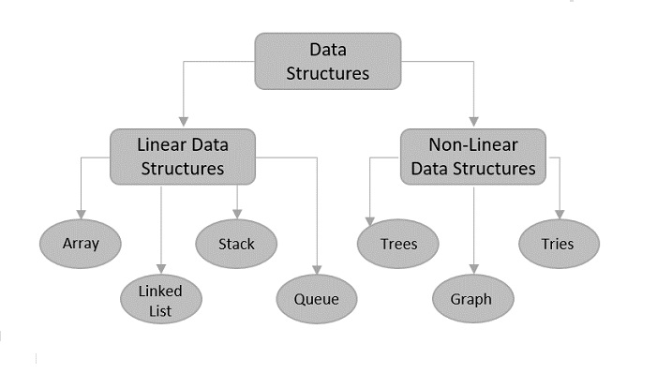
[5-mins]
Classification of Data Structures :

Slide 12
Applications of Data Structures
Data structures are used in various fields such as:
▶ Operating system
▶ Graphics
▶ Computer Design
▶ Blockchain
▶ Genetics
▶ Image Processing
▶ Simulation
▶ ...
[5-mins]

Slide 13
▶ What is an algorithm?
An algorithm is a set of rules for carrying out calculation either by hand or on a machine.
An algorithm is a sequence of computational steps that transform the input into output.
An algorithm is a sequence of operations performed on data that have to be organized in data structures.
A finite set of instructions that specify a sequence of operations to be carried out in order to solve a specific problem or class of problems.
An algorithm is an abstraction of a program to be executed on a physical machine.
An algorithm is any well-defined computational procedure that takes some value, or set of values, as input and produces some value, or set of values, as output.

Slide 14
▶ Why do we study algorithms?
To make solution more faster.
To compare performance as a function of input size.
Two main property of algorithm is:
1. Correctness: Does the algorithm give solution to the problem in a finite number of steps?
2. Efficiency: How much resources in terms of memory and time, does it take to execute the algorithm

Slide 15
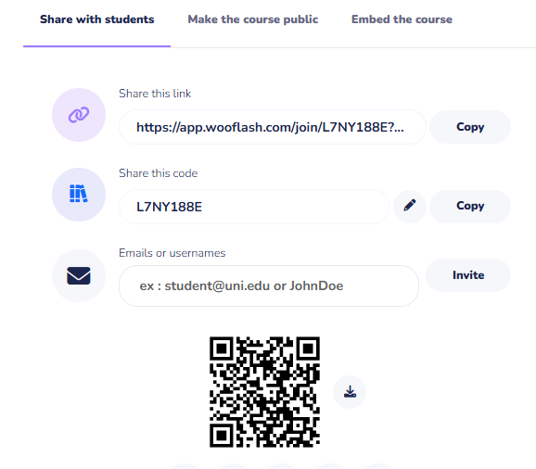
Assessment: WooFlash Quiz

Slide 16
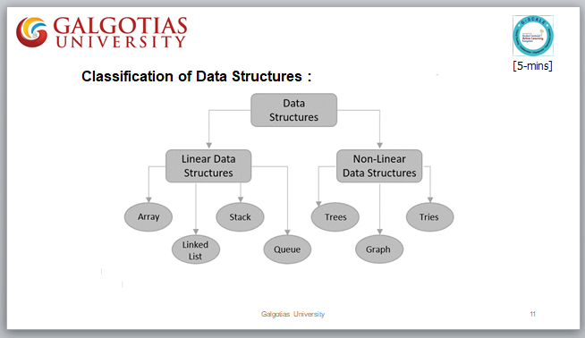
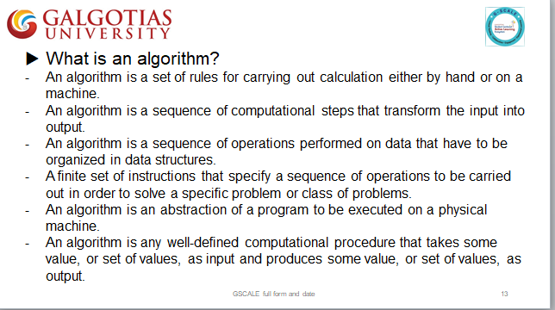
Summary
[1-mins]

Slide 17
[2-mins]
Ensure attainment of LO’s in alignment to the learning activities:
Define key terms related to data structures such as data, data type, abstract data type (ADT), and operations..
Classify different types of data structures and identify real-life applications for each.

Slide 18
[1-min]
Next Session:
Efficient Algorithm, Complexity & Asymptotic Notation

Slide 19
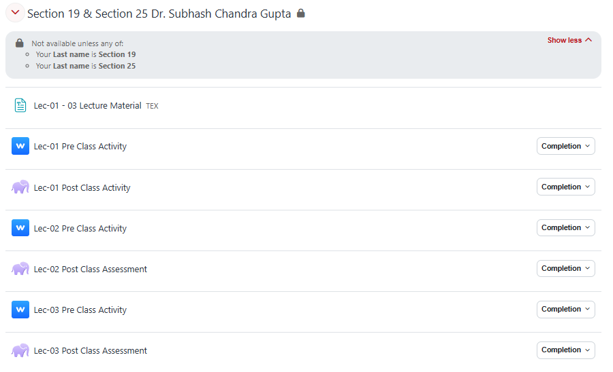
Review and Reflection from students

